Slide 1
Marketing Analysis Final Project
Ibrahim Ayman
Eslam Tamer
Bassem Shams
Mustafa Sultan
Last Edited: Oct 2025

Slide 2
Why Are We Here Today
ShopEasy, an online retail business, is facing reduced engagement, lower conversion rates with unclear customer sentiment. Our goal is to deliver a full analysis identifying root causes, cleaning data, building KPIs, and presenting insights with business recommendations.

Slide 3
Workflow
SQL (Data Cleaning) ➔ Python (Sentiment Analysis) ➔ Power BI (Analysis & Visualization)
Brief Explanation: We cleaned and prepared the data using SQL, then used Python for customer sentiment analysis, and finally, built an interactive Power BI dashboard to extract actionable insights.

Slide 4
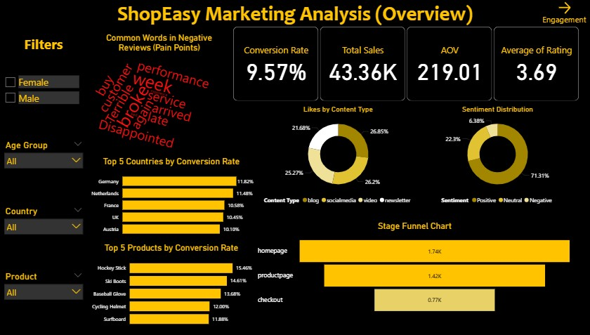

Slide 5
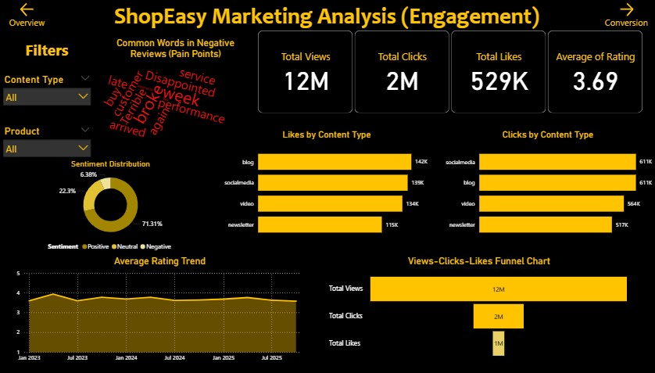

Slide 6
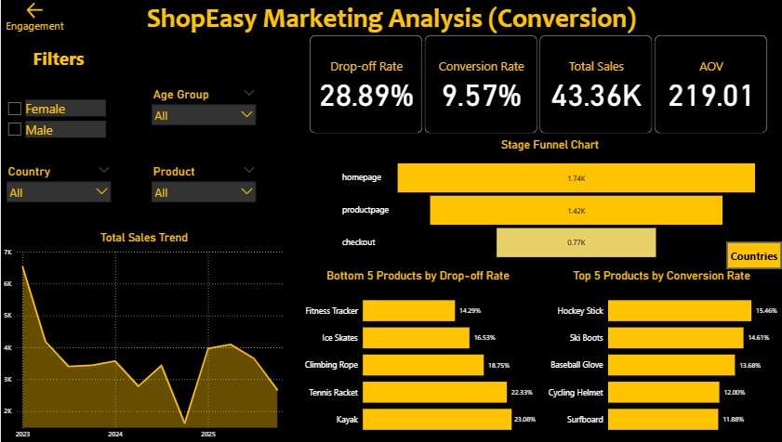

Slide 7
Insights
Customer Satisfaction Issue: Primarily caused by logistics (delivery delays, damaged products), not marketing.
Engagement Opportunity: Content types performance is nearly the same
Conversion Bottleneck: The biggest customer drop-off occurs immediately before the checkout step.
Growth Opportunity: The German and Dutch markets are the top-performing regions and represent a clear opportunity for rapid growth.

Slide 8
Recommendations
For the Customer Satisfaction Issue: Review and improve the entire logistics process, focusing on shipping carriers and product packaging to reduce delays and prevent damage.
For the Engagement Opportunity: Since content performance is flat, launch an A/B testing initiative to experiment with new and diverse content formats to discover what truly resonates with the audience.
For the Conversion Bottleneck: Simplify the checkout process by reducing steps and increasing transparency. Display all costs, like shipping and taxes, upfront to build trust and reduce last-minute drop-offs.
For the Growth Opportunity: Reallocate marketing budget and increase targeted campaign efforts in the high-performing German and Dutch markets to accelerate growth and maximize return on investment.

Slide 9
Any Questions?

